Slide 1
Data Analysis and Insights for E-commerce Sales
Clustering Insights ,Correlation Analysis, Top Products and Sales Trends
Name : Prerna Anant Palsapure
Date : 14/1/2025

Slide 2
INTRODUCTION
In this analysis, we explore the relationships between various product and sales features, uncover key trends, and identify actionable insights to improve sales performance.
We'll cover the clustering insights, correlation matrix, top-selling products, and sales distribution over time.

Slide 3
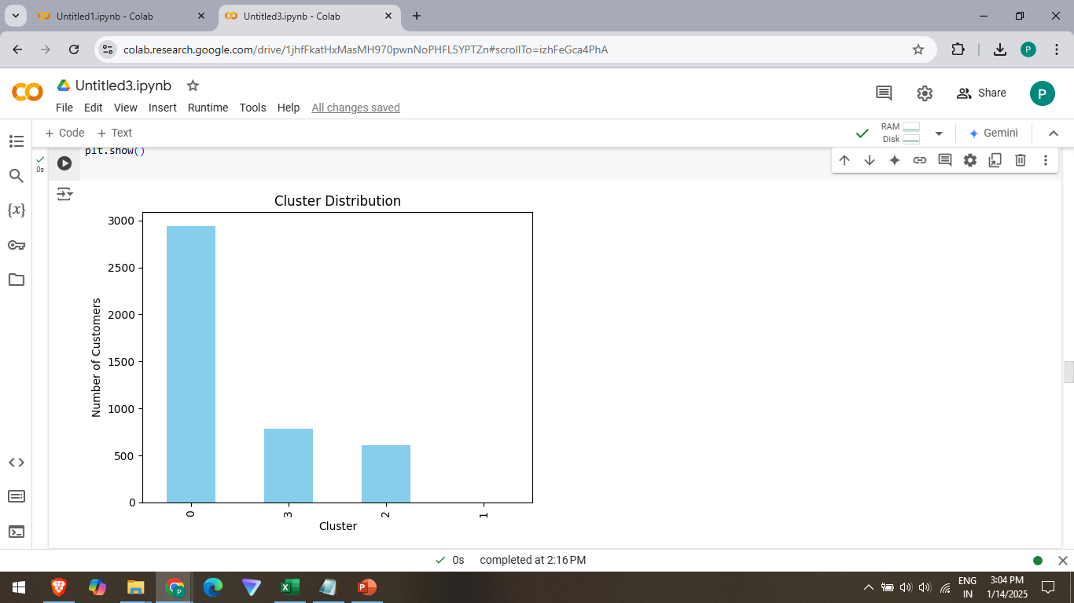
Cluster Distribution Insights
INSIGHTS:
Cluster 0 has the highest number of customers, which indicates that this cluster represents the largest segment in the dataset. Since it contains the most customers, this cluster could represent a general population of customers who don’t fit into specific niche groups. It could also represent frequent buyers or those with average purchase behavior.
Other Clusters: The smaller clusters could represent specialized groups—for example, VIP customers, seasonal buyers, or those with low-frequency purchases.

Slide 4
Actionable Recommendations for Cluster Distribution
Target Cluster 0 with Broad Campaigns: Given that it represents the majority of customers, focus on general marketing campaigns and loyalty programs aimed at retaining these customers.
Tailor Strategies for Smaller Clusters: For the other clusters, create targeted campaigns based on the unique behaviors of those segments, such as:
Offering special promotions for VIP customers or high-value customers in the smaller clusters.
Creating seasonal offers for customers in a niche segment who buy products during specific times.

Slide 5
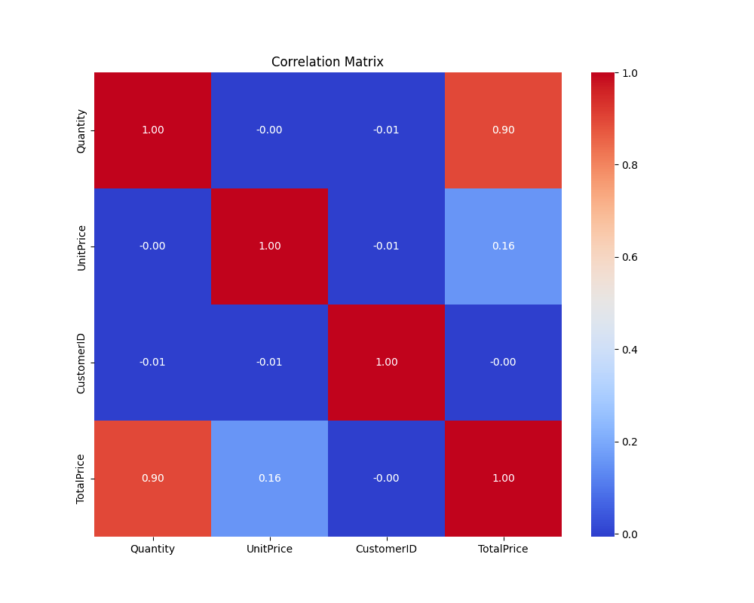
Key Findings from the Correlation Matrix
TotalPrice vs Quantity (0.90): Strong positive correlation suggests increasing quantity will significantly boost total revenue.
UnitPrice vs TotalPrice (0.16): Weak positive correlation means unit price has a smaller impact on revenue.
CustomerID vs Quantity (-0.01): Customer identity has no significant effect on quantity sold.
UnitPrice vs CustomerID (-0.01): Pricing is standardized across customers, indicating no direct relationship.
CustomerID vs TotalPrice (-0.00): No correlation between customer identity and total revenue.
UnitPrice vs Quantity (-0.00): No meaningful relationship between unit price and quantity sold.

Slide 6
Actionable Insights
Increase Sales Volume: Since quantity sold strongly correlates with revenue, prioritize strategies that drive higher sales volume.
Focus on Product Offerings: Sales performance is not driven by customer identity; instead, concentrate on optimizing product offerings.
Explore Dynamic Pricing: With weak correlation between unit price and quantity, consider dynamic pricing strategies.
Promotions & Marketing: Shift focus to promotions and marketing strategies that increase sales volume rather than relying on pricing adjustments alone.

Slide 7
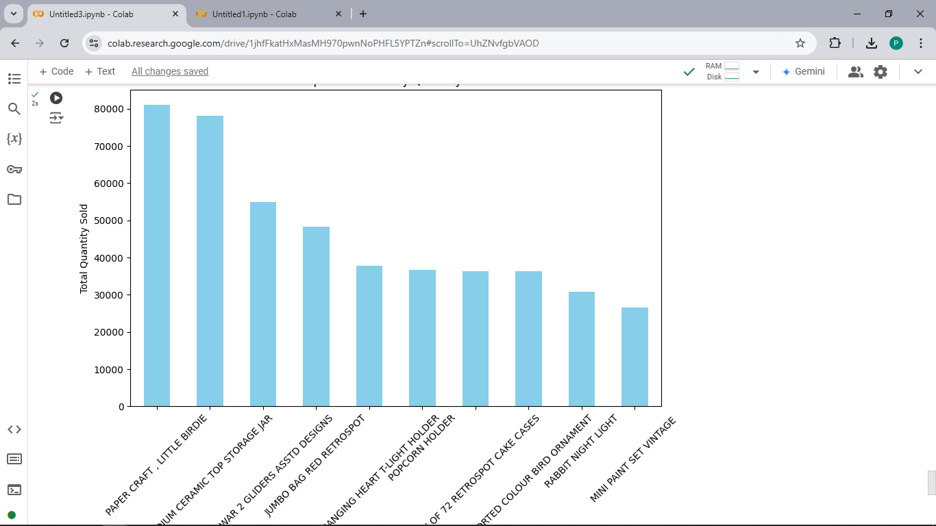
Top-Selling Products
Top 5 products:
Paper Craft, Little Birdie: Strong sales in the crafting niche.
Medium Ceramic Top Storage Jar: Popular home decor and practical storage item.
World War 2 Gliders Assorted Designs: Niche item catering to collectors and enthusiasts.
Jumbo Bag Red Retrospot: Practical, functional product with style appeal.
White Hanging Heart T-Light Holder: Decorative lighting item popular among home decor shoppers.

Slide 8
Key Insights and Recommendations
Key Insights:
Diverse Customer Base: Customers are interested in a wide variety of products, from DIY and crafting to home decor and military memorabilia.
Seasonal & Trend-Driven Demand: Certain products may be influenced by specific trends, seasons, or niche markets.
Home Decor & Functional Items Lead Sales: Products related to home organization and decoration perform particularly well.
Recommendations:
Focus marketing efforts on niche products like the Paper Craft and WWII gliders by reaching out to specific communities (crafting enthusiasts, collectors).
For home decor products, consider seasonal or themed campaigns to take advantage of ongoing trends in home improvement and decoration.
Leverage promotions and bundles around popular product categories like decorative lighting and storage solutions.

Slide 9
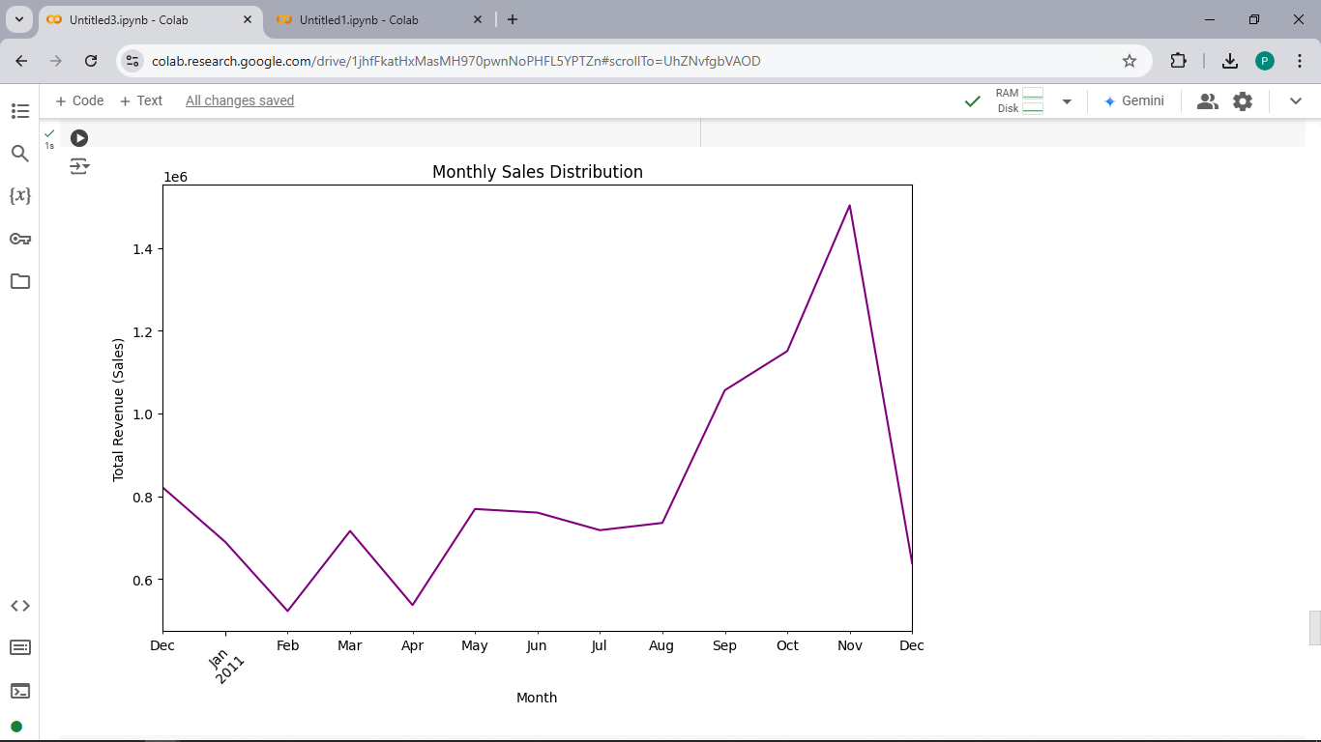
Sales Distribution Over Time (Monthly Sales Trend)
August to November: There is a consistent increase in sales, possibly driven by seasonal demand or promotions (e.g., Black Friday, holiday shopping). This period represents a peak in revenue, highlighting the importance of leveraging marketing and promotions during these months.
Other months (January-July): Sales show fluctuations, with periods of increase and decrease. This variability could be due to seasonal lulls, post-holiday effects, or inventory availability.

Slide 10
Recommendations
Plan seasonal marketing campaigns for late summer and fall to capitalize on increased demand. Additionally, focus on inventory management and customer retention strategies during the off-peak months.

Slide 11
Conclusion & Next Steps
This analysis provides critical insights into the factors influencing sales performance.
Next Steps: Implement the recommendations to optimize marketing efforts, pricing strategies, and product offerings.
Emphasize that a combination of data-driven decisions and targeted strategies will help maximize revenue and customer satisfaction.

Slide 12
THANKYOU

